Slide 1
Data Analyst Machine Test
Development Time: 6 hours
There are two tests in this round
First test is related to Excel skill
Second test is related to problem solving ability

Slide 2
Excel Test
Create a report for the data which shared in the slide 3 attached excel sheet
Please refer the required report from the slide 4 and 5.
Use Power Query, Power Pivot and Slicer
Development Time: 5 hours

Slide 3
Source Data
Please find the data in the attached zip
The zip has one excel file and the excel file has 3 sheets
Input sheet is used for drop down and FY-Period-Week Calendar
Resource sheet is used to add resource details
Effort sheet is used to enter their effort per week

Slide 4
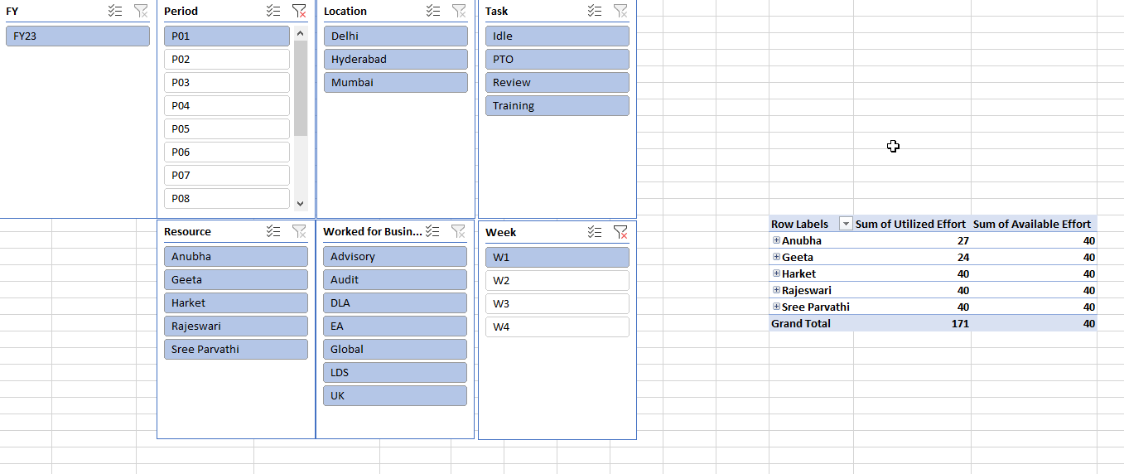
Report-1
This report to check how much effort utilized versus available effort (8 hrs. per day) per resource
Add slicer to filter FY-Period-Week, Task, Resource, and worked for Business

Slide 5
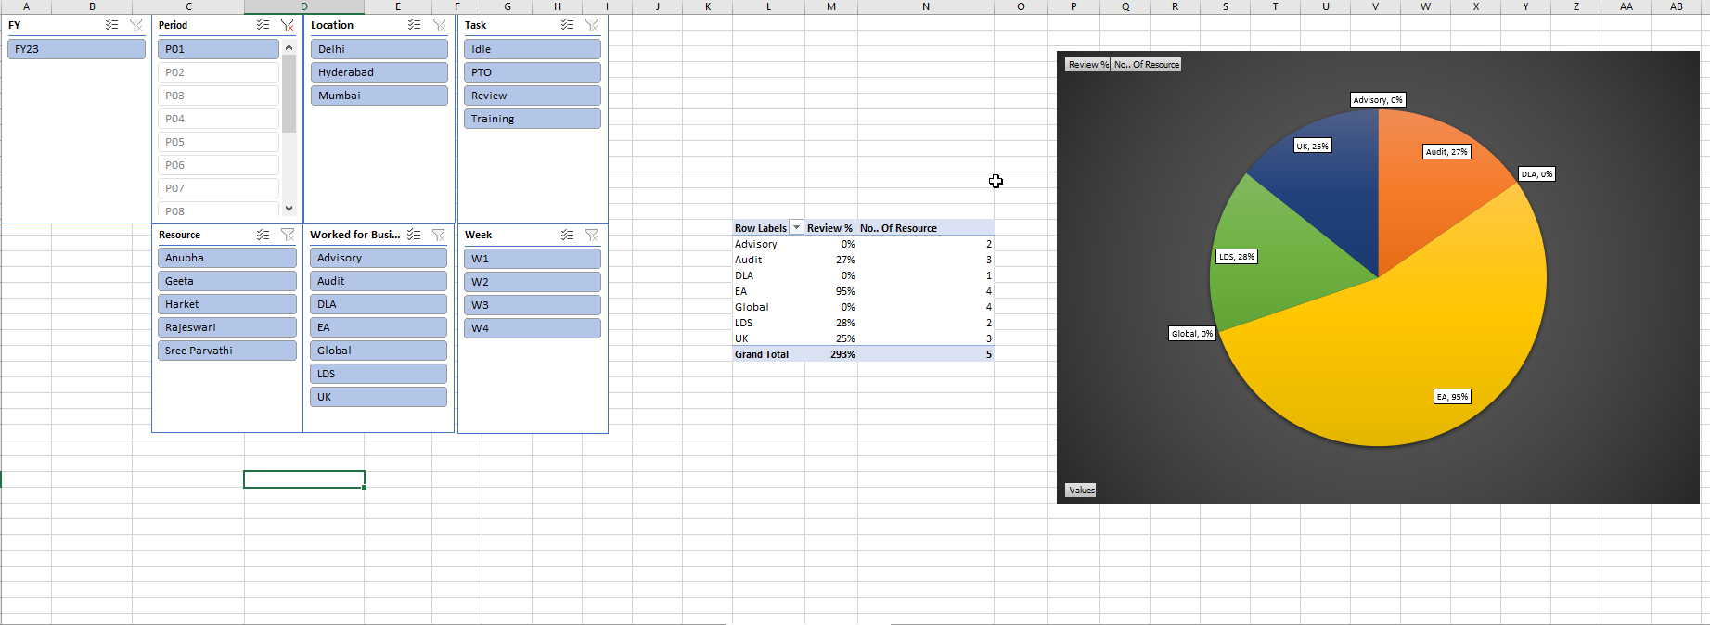
Report-2
This report to check how much effort utilized only in review task (As Percentage, example 20 hrs. in period (1 period is equal to 20 days) then 20/(8*20)= 12.5%
How many resource worked in each business
Add slicer to filter FY-Period-Week, Resource, and worked for Business

Slide 6
Problem solving Test
Please go through the problem statement in the next slides and use VBA/JavaScript to solve the problem
Development Time: 1 hour

Slide 7
Problem
Roy wants to change his profile picture on Facebook. Now Facebook has some restriction over the dimension of picture that we can upload. Minimum dimension of the picture can be L x L, where L is the length of the side of square.
Now Roy has N photos of various dimensions. Dimension of a photo is denoted as W x H where W - width of the photo and H - Height of the photo
When any photo is uploaded following events may occur:
[1] If any of the width or height is less than L, user is prompted to upload another one. Print "UPLOAD ANOTHER" in this case. [2] If width and height, both are large enough and (a) if the photo is already square then it is accepted. Print "ACCEPTED" in this case. (b) else user is prompted to crop it. Print "CROP IT" in this case.
(quotes are only for clarification)
Given L, N, W and H as input, print appropriate text as output.

Slide 8
Input: First line contains L. Second line contains N, number of photos. Following N lines each contains two space separated integers W and H.
Output: Print appropriate text for each photo in a new line.
Sample Input
L=180
N=3
Photo=[
{W:640,H:480}
{W:120,H:300}
{W:180,H:180}
]
Sample Output
CROP IT
UPLOAD ANOTHER
ACCEPTED

